Slide 1

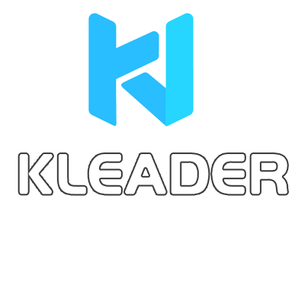






KLEADER
AI camera
24-hour after-sales service
Excellent value and low price,
available for rent or sale
1000+ interactive multimedia products, free proposal quotation
Kleader Website：www.klmultimedia.com

Slide 2






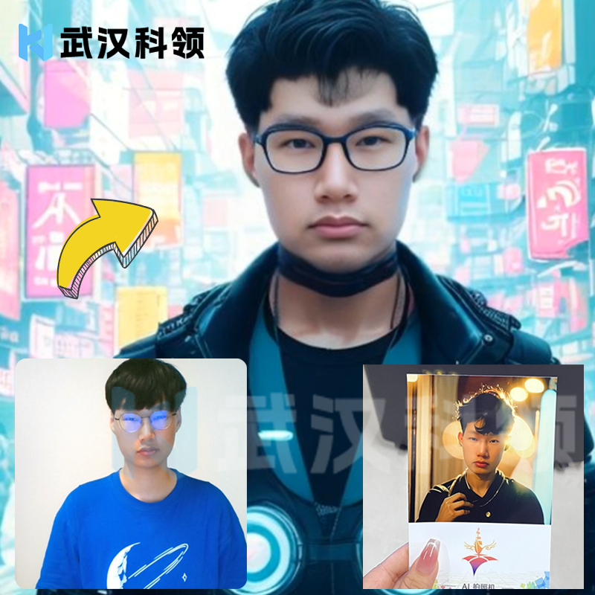

Product Introduction
Product Introduction
Product creativity:
AI painting, AI dressing, time photography studio, the magic wand of future fashion. Switch from retro palace to future science fiction with one click. Accurate identification, fine-tuning of details, every hair and every inch of fabric is just right. No longer limited by the wardrobe, let imagination become your wardrobe. AI dressing makes fashion within reach and extends personality infinitely.
Product experience:
AI camera specially designed for event rental, the system not only has built-in multiple styles of painting, but also supports custom descriptions of painting photos. It also supports custom themes, custom theme photo frames, stickers, signatures, which can be rented or sold. A large-screen starry sky photo wall display is provided. AI brings unlimited possibilities to your event

Slide 3


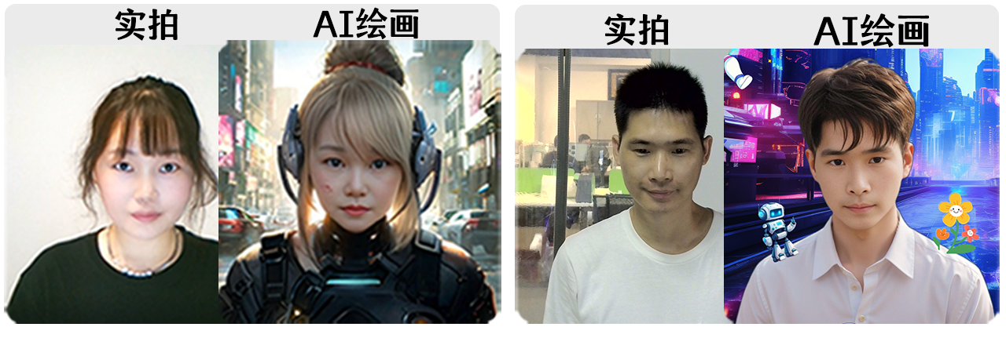


Photo case
Photo Case
Personal selfie
Real-life photo
AI-generated art
Real-life photo
AI-generated art

Slide 4

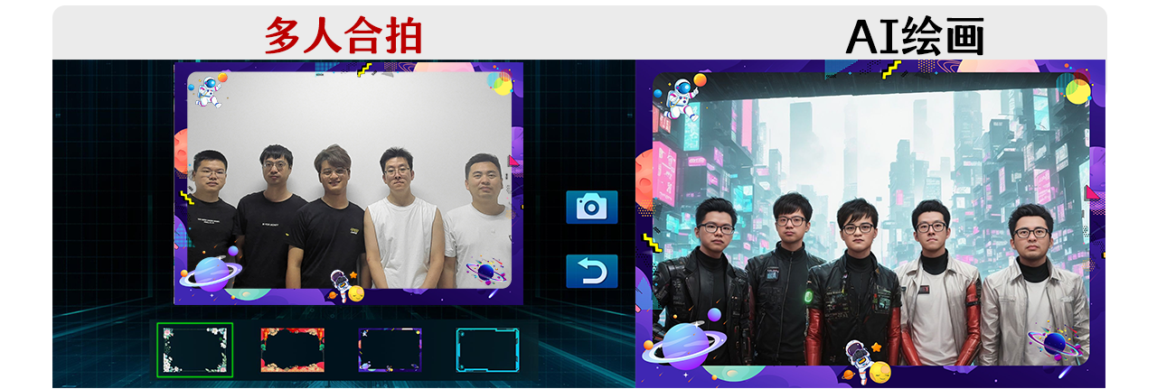

Photo case
Photo Case
group photo
Group photo
AI-generated art

Slide 5
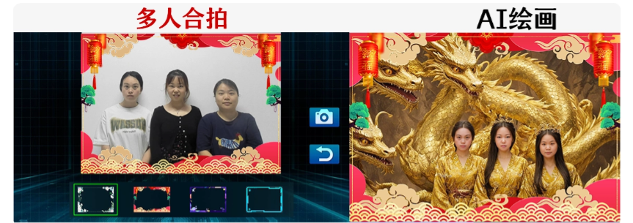
Photo case
Photo Case
group photo
Group photo
AI-generated art

Slide 6

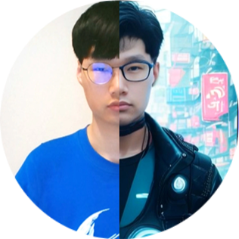










Marketing Advantages
Marketing Advantages
Save labor costs
Brand promotion
Automation: Reduce manual intervention and lower operational costs.
Efficient Management: Automatically categorize and organize photos, saving time on post-processing.
Customisation: Tailor the photography style and background based on the event theme to enhance the brand image.
Social Media: Share event photos on social platforms to increase brand visibility.
Enhance engagement
Enhance the experience
Interactive Features: Enhance participant interaction through AI technology, such as real-time filters and effects. Fun Factor: Introduce AI technology to make the photo experience more enjoyable, attracting more participants.
Smart Photography: Automatically adjust camera settings in real-time to ensure each photo is clear and perfect.
Instant Sharing: Support one-click sharing to enhance event engagement and interaction.

Slide 7






Why choose Kleader AI camera
Product Advantages
Many styles
Scan QR code to save photo
The system includes 84 AI art styles. After taking photos, users can change scenes, outfits, and character traits. New style models will be upgraded for free.
No restrictions on WeChat or Apple Camera. Foreign customers can also scan the QR code to retrieve.
AI cutout to change background
Offer various photo wall options.
Background image can be changed, placing users in any scenic spot or commercial setting.
Free large-screen photo display walls, which will be upgraded later
Add stickers
Free 1000 AI drawing traffic
Supports zoom in, zoom out, rotate, delete, and unlimited additions.
Future top-ups come with many discounts on data.
Signature
Supports custom photo frames
Optional pen color, adjustable pen thickness
You can change the photo frame and add business event information to boost your commercial promotion and monetization.

Slide 8













Why choose Kleader AI camera
Product Advantages
Supports custom descriptions for AI-generated art.
Supports printing photos with any printer.
Generate images based on your description using AI, and add them to custom styles.
Supports group photos.
Supports adding and deleting custom top styles, and hiding unwanted styles.
Group-wide AI style transformation.
Supports photography with any camera, capture card, or DSLR camera.
The software interface supports custom changes.
You can add your business information on the interface.
...
The software supports auto-adjustment for both landscape and portrait modes.

Slide 9


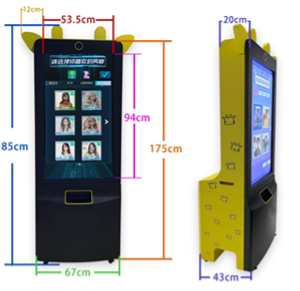
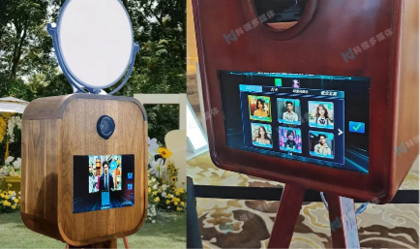




Product specifications
Product Parameters
All-in-one size and system components (available for rent or sale)
System components = Customized touch all-in-one machine + 4K HD camera + Dye-sublimation printer and consumables + Kleader AI photography software + Internet connectivity.
Portrait version
Landscape version

Slide 10
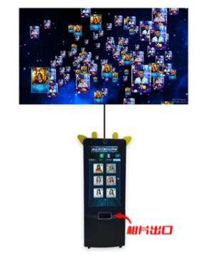
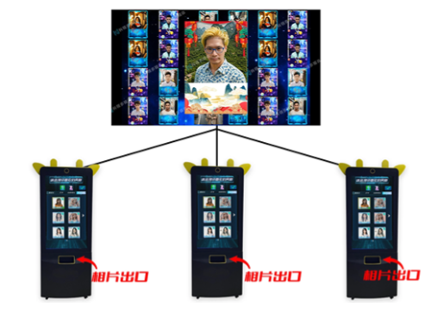

Event plan
Activity Program
Can be networked with multiple units or used as a standalone device.
Photo exit
Photo exit
Photo exit
Photo exit
Extended display mode
Network mode

Slide 11
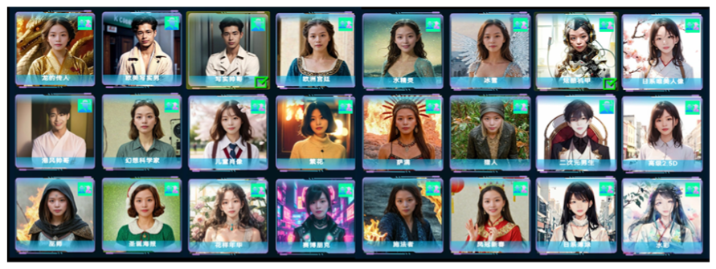

Style display
Style display
Men’s style:

Slide 12
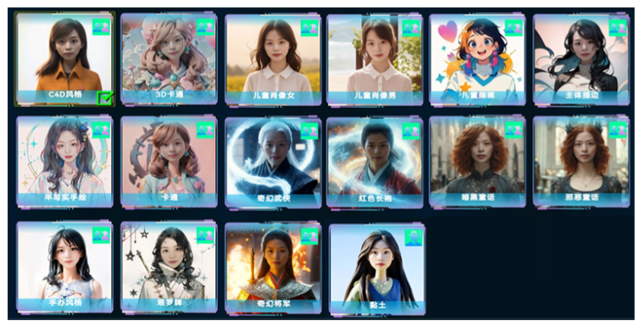
Style display
Style display
Men’s style:

Slide 13
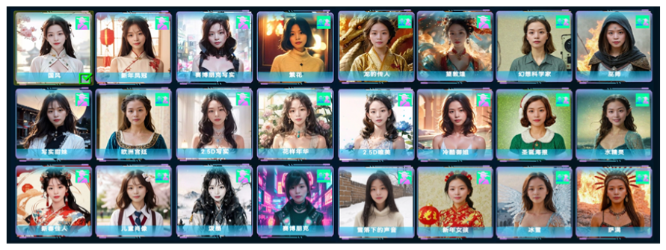

Style display
Style display
Women's style

Slide 14
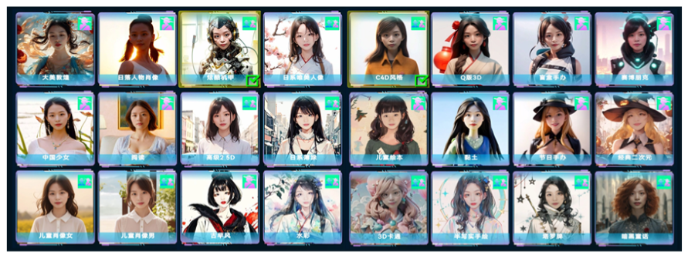
Style display
Style display
Women's style

Slide 15
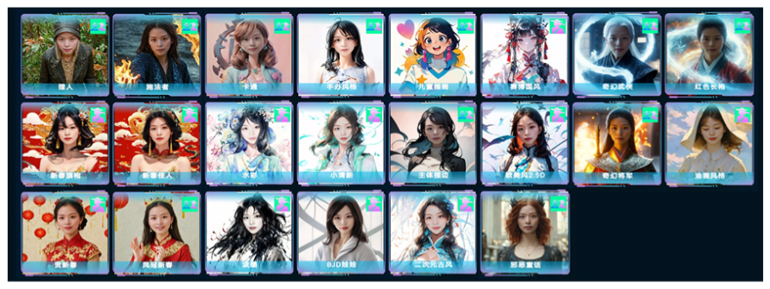
Style display
Style display
Women's style

Slide 16
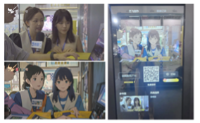

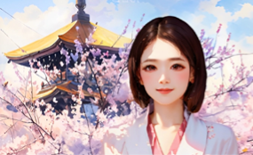
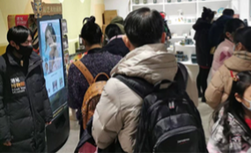

Application Scenario
Application Scenario
Cultural tourism
Event
Exhibition hall
Whether it's a corporate conference or a social gathering, our AI avatar customization service generates a personalized avatar for each participant that aligns with the event theme, enhancing interactivity and elevating the event experience.
In cultural and tourism events, our AI technology generates personalized photos for visitors based on the unique features and culture of the attractions. By incorporating local scenic landmarks and architectural styles, we create distinctive travel mementos, enhancing the overall tourist experience.
In the exhibition hall, our AI avatar customization service provides each visitor with a unique, personalized avatar that matches the style of the exhibition, enhancing the brand image and making the display more engaging.

Slide 17
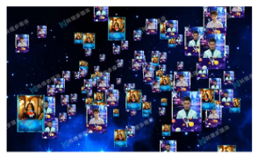
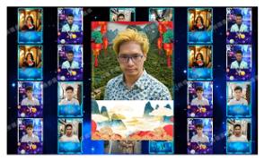
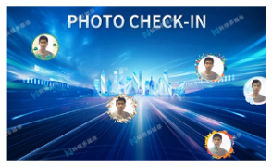
Free content
Give away content
Offer a variety of large-screen photo display walls.
Starry sky photo wall
Flowing water photo wall
Floating photo wall

Slide 18
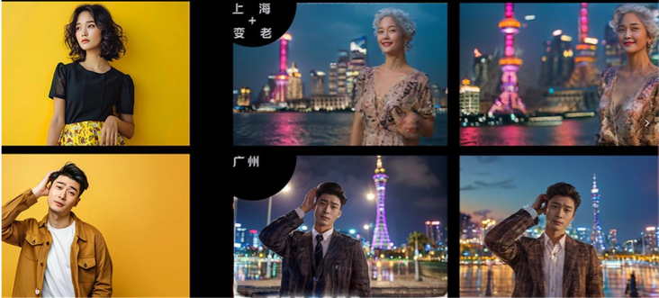


Scene customization examples
Customized Cases
AI-generated regional feature customization

Slide 19
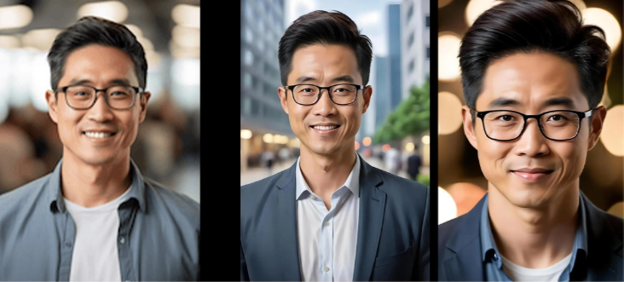
Scene customization examples
Customized Cases
AI-generated clothing style customization

Slide 20

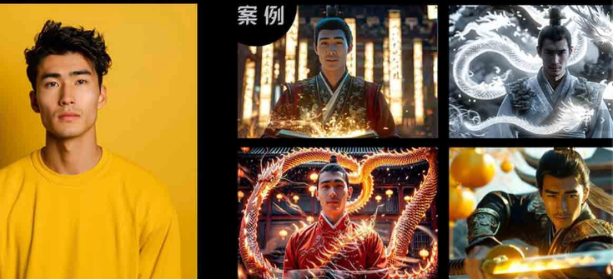
Scene customization examples
Customized Cases
AI-generated special effects style customization
CASE

